Slide 1


Predictive analytics
for a facial emotion recognition task
Group 8
Jiancong Shen, Vikki Sui, Jinxu Xiang, Ruiqi Xie, Wenjie Xie
Presenter: Jinxu Xiang

Slide 2


CONTENTS
01 Data preprocessing
02 Feature extraction
03 Classifier application
04 Conclusion

Slide 3
01
Data preprocessing
Including rotation, zooming and translation.

Slide 4
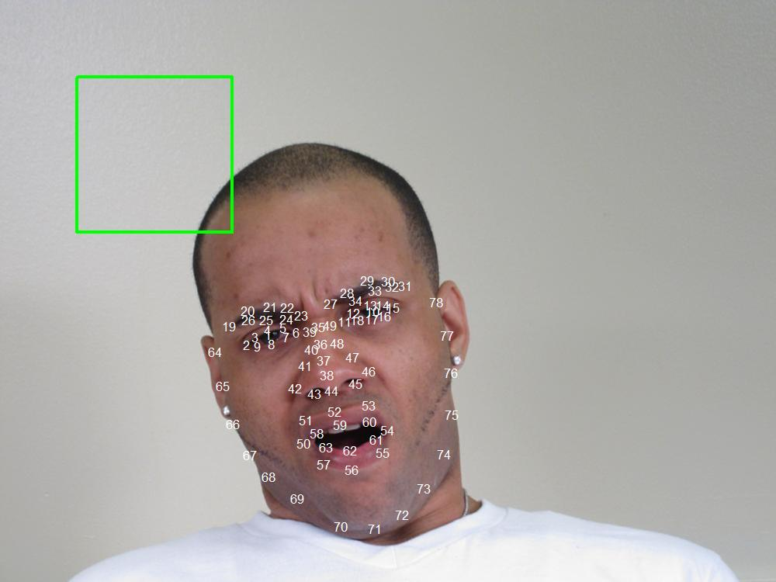
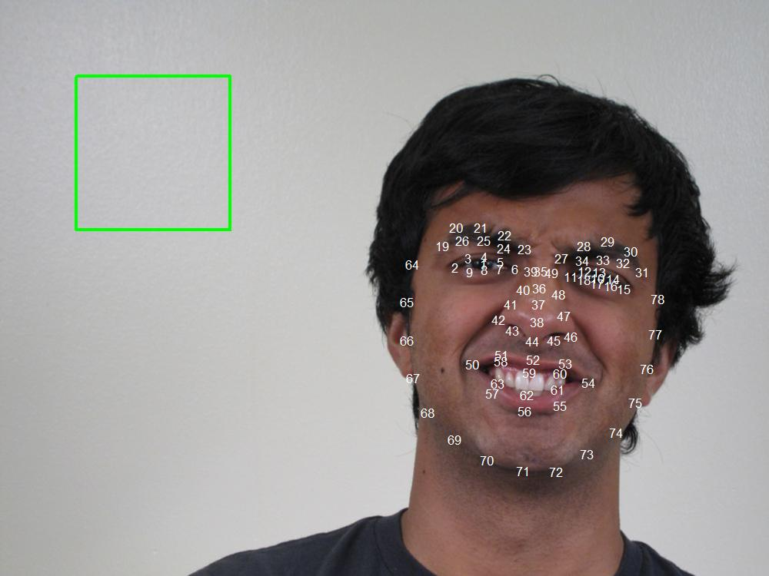
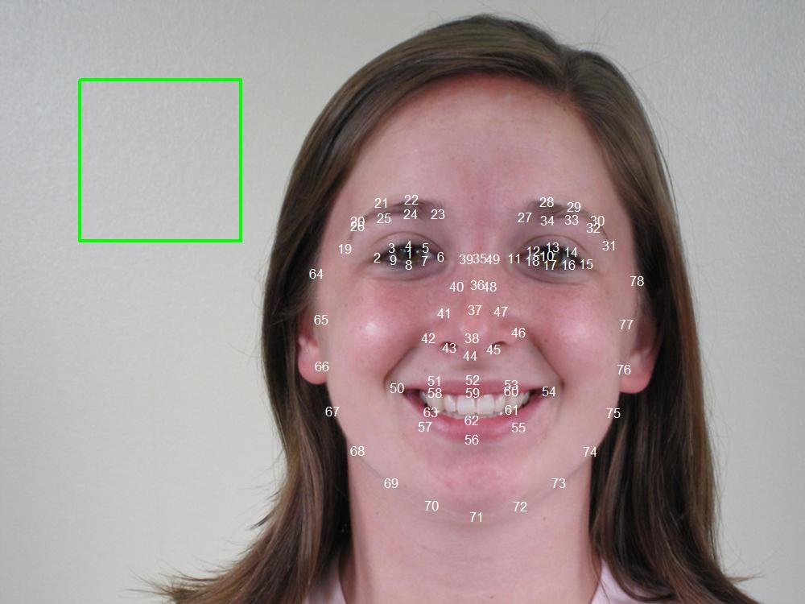
Data preprocessing - 1
The area surrounded by the green square is in the range of 100 and 300 of x and y. This is used to help confirm the location of the image pixels.
Image 2375
Image 0944
Image 0113
The person's head in this picture is severely tilted to the right and the face area is small.
The person's head in this picture is slightly tilted to the left, the face area is small, and most of them are on the right side of the image.
The person's face area is slightly off-center.

Slide 5
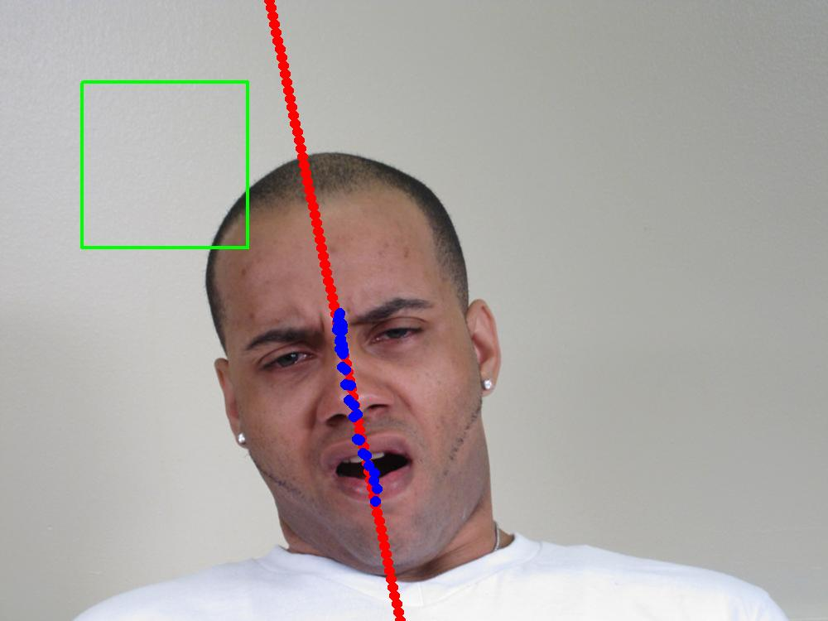
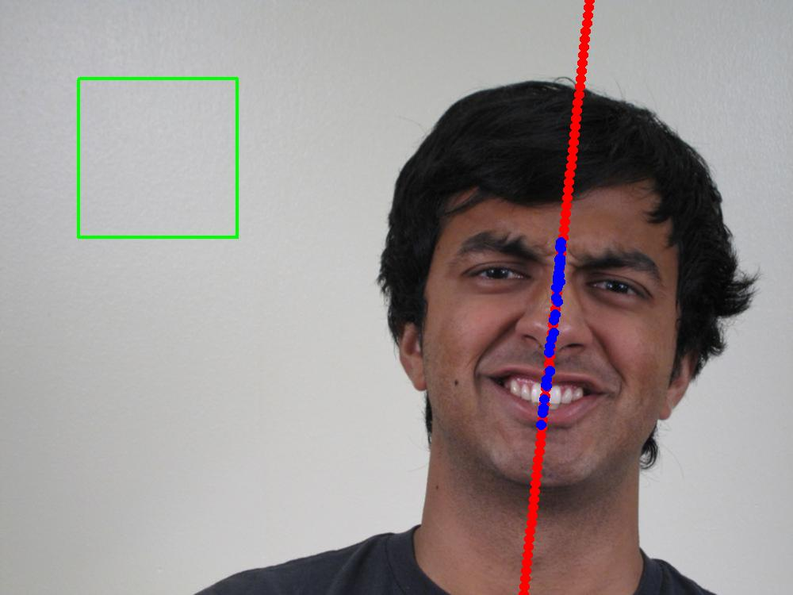
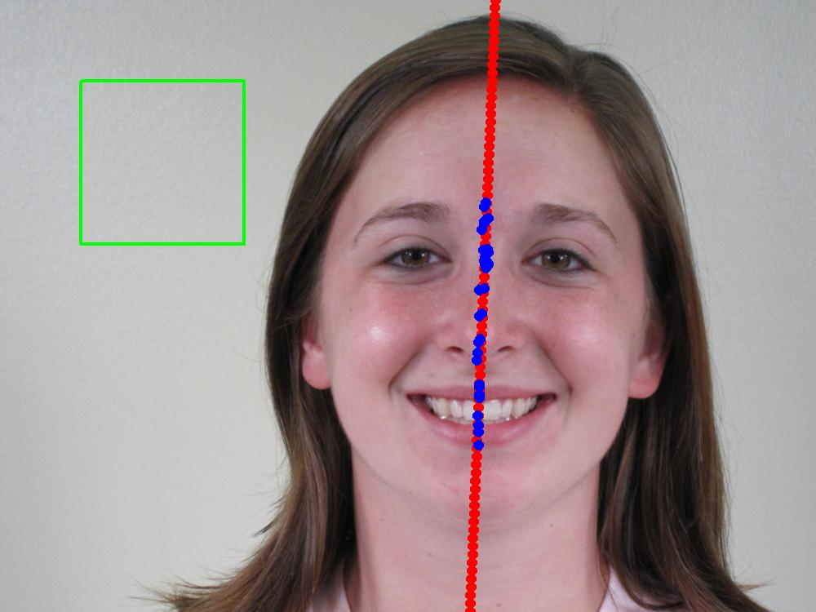
The blue points are the midpoint of the symmetrical points of the face and the single points of the face.
The red line is the regression line of the blue points. Note that we have to do lm(x~y), otherwise the coefficient is infinity.
Data preprocessing - 2
Image 2375
Image 0944
Image 0113
The person's head in this picture is severely tilted to the right and the face area is small.
The person's head in this picture is slightly tilted to the left, the face area is small, and most of the area is on the right side of the image.
The person's face area is slightly off-center.

Slide 6
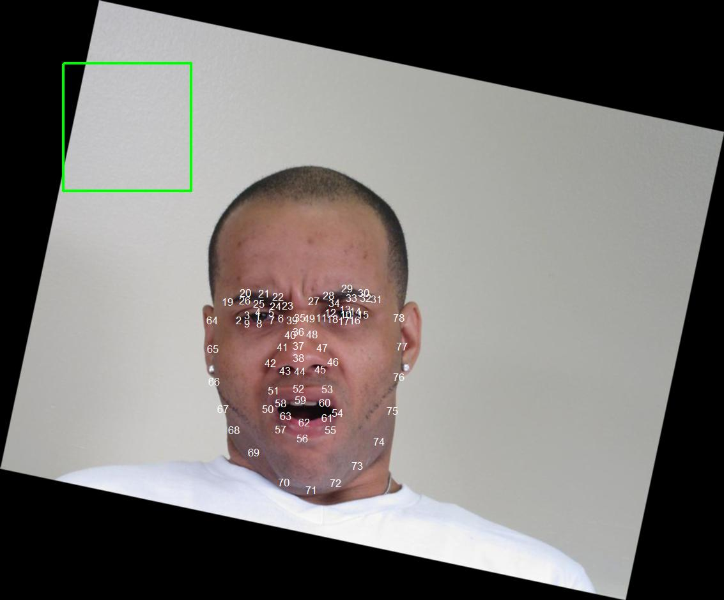
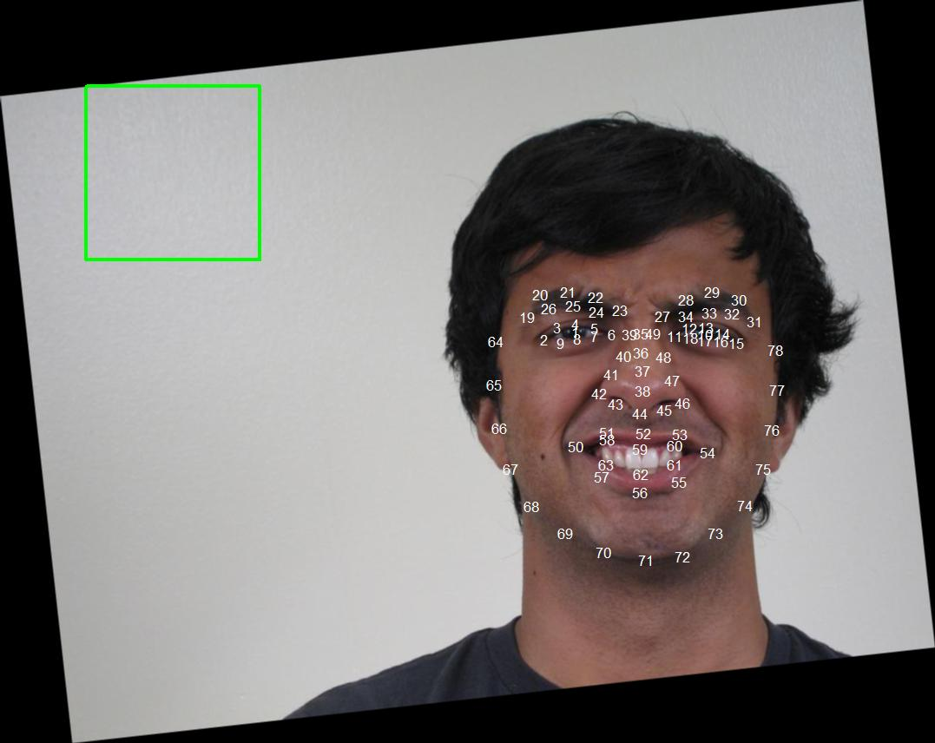
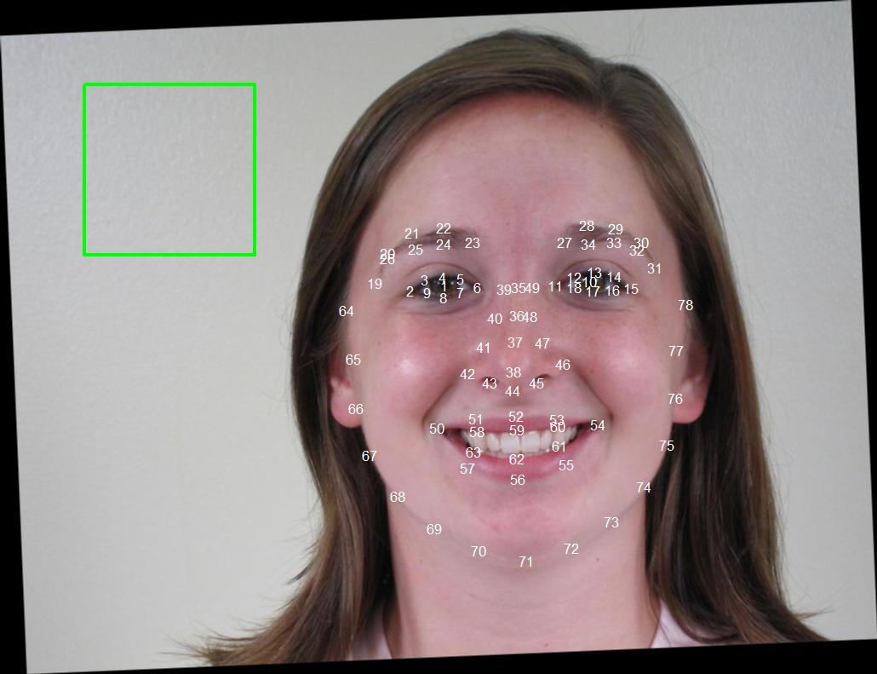
Data preprocessing - 3
The black area is created by the rotation function of EBImage. For different directions of rotation, the transformation of points requires different formulas. We can see that everyone's face are now vertical.
Image 2375
Image 0944
Image 0113
The person's face area is small and his head in not exactly at the center of the image.
The person's face area is small and most of the area is on the right side of the image.
The person's face area is slightly off-center.

Slide 7
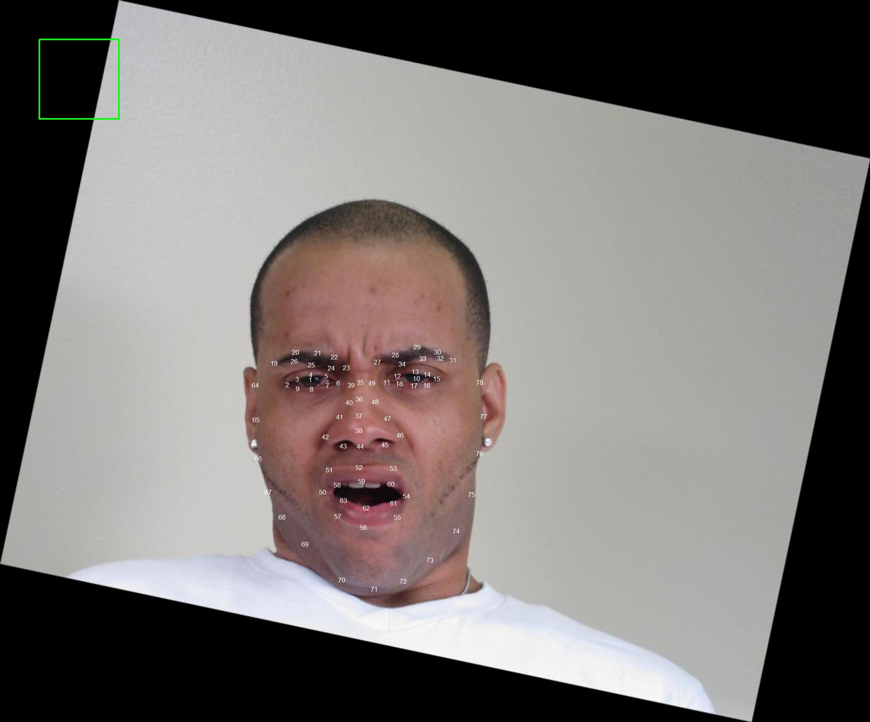
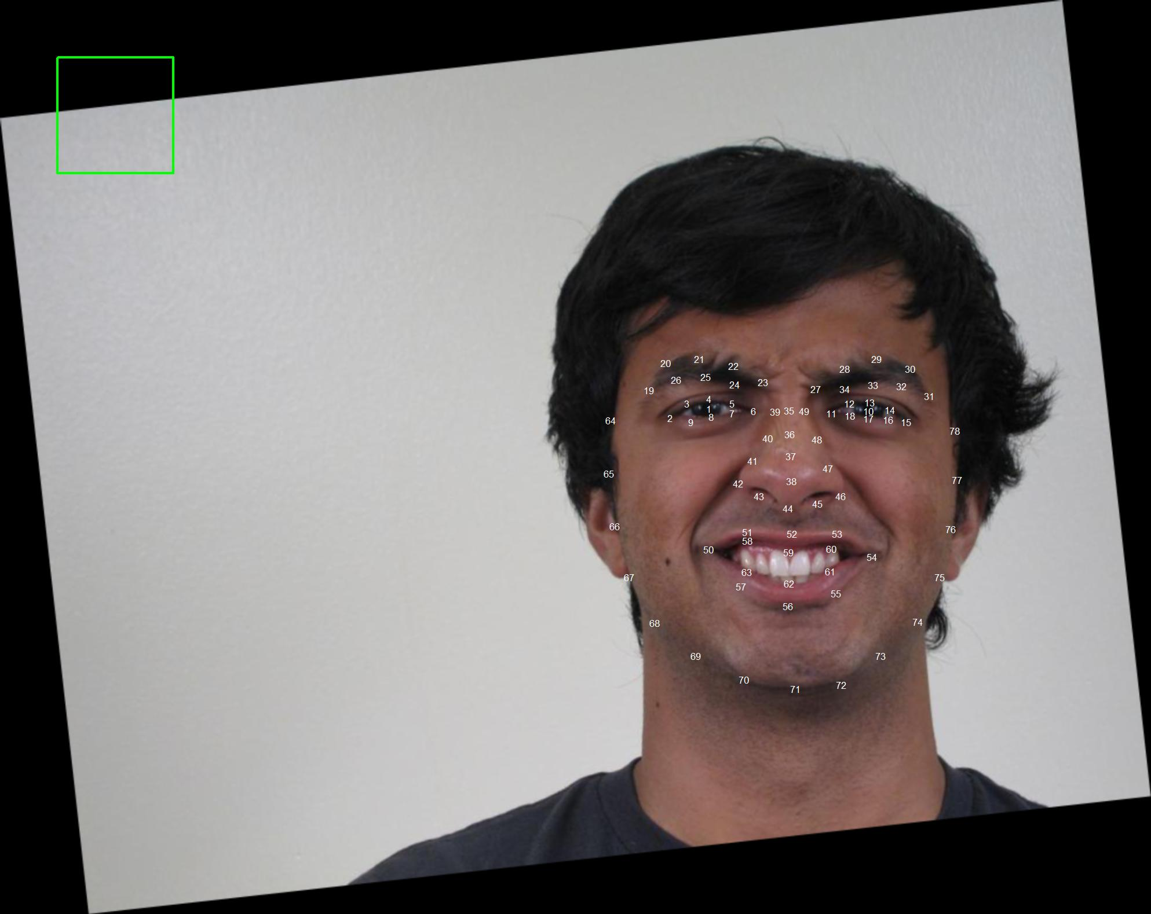
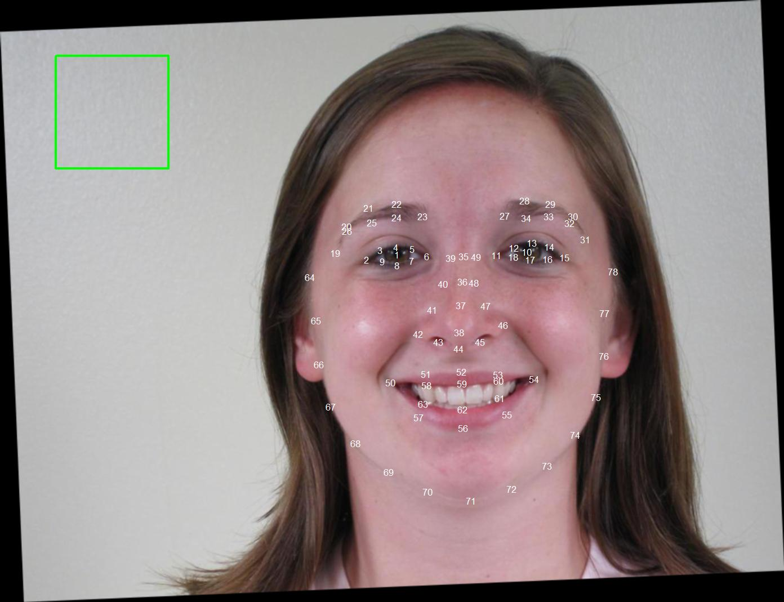
Data preprocessing - 4
We choose the distance between the midpoint of two pupils and the bottom of the nose as a fix distance to zoom every images. Looking at the area of the green square, it still represents 100-300 for x and y.
Image 2375
Image 0944
Image 0113
The person's face area is slightly off-center.
The person's face area is off-center.
The person's face area is slightly off-center.

Slide 8
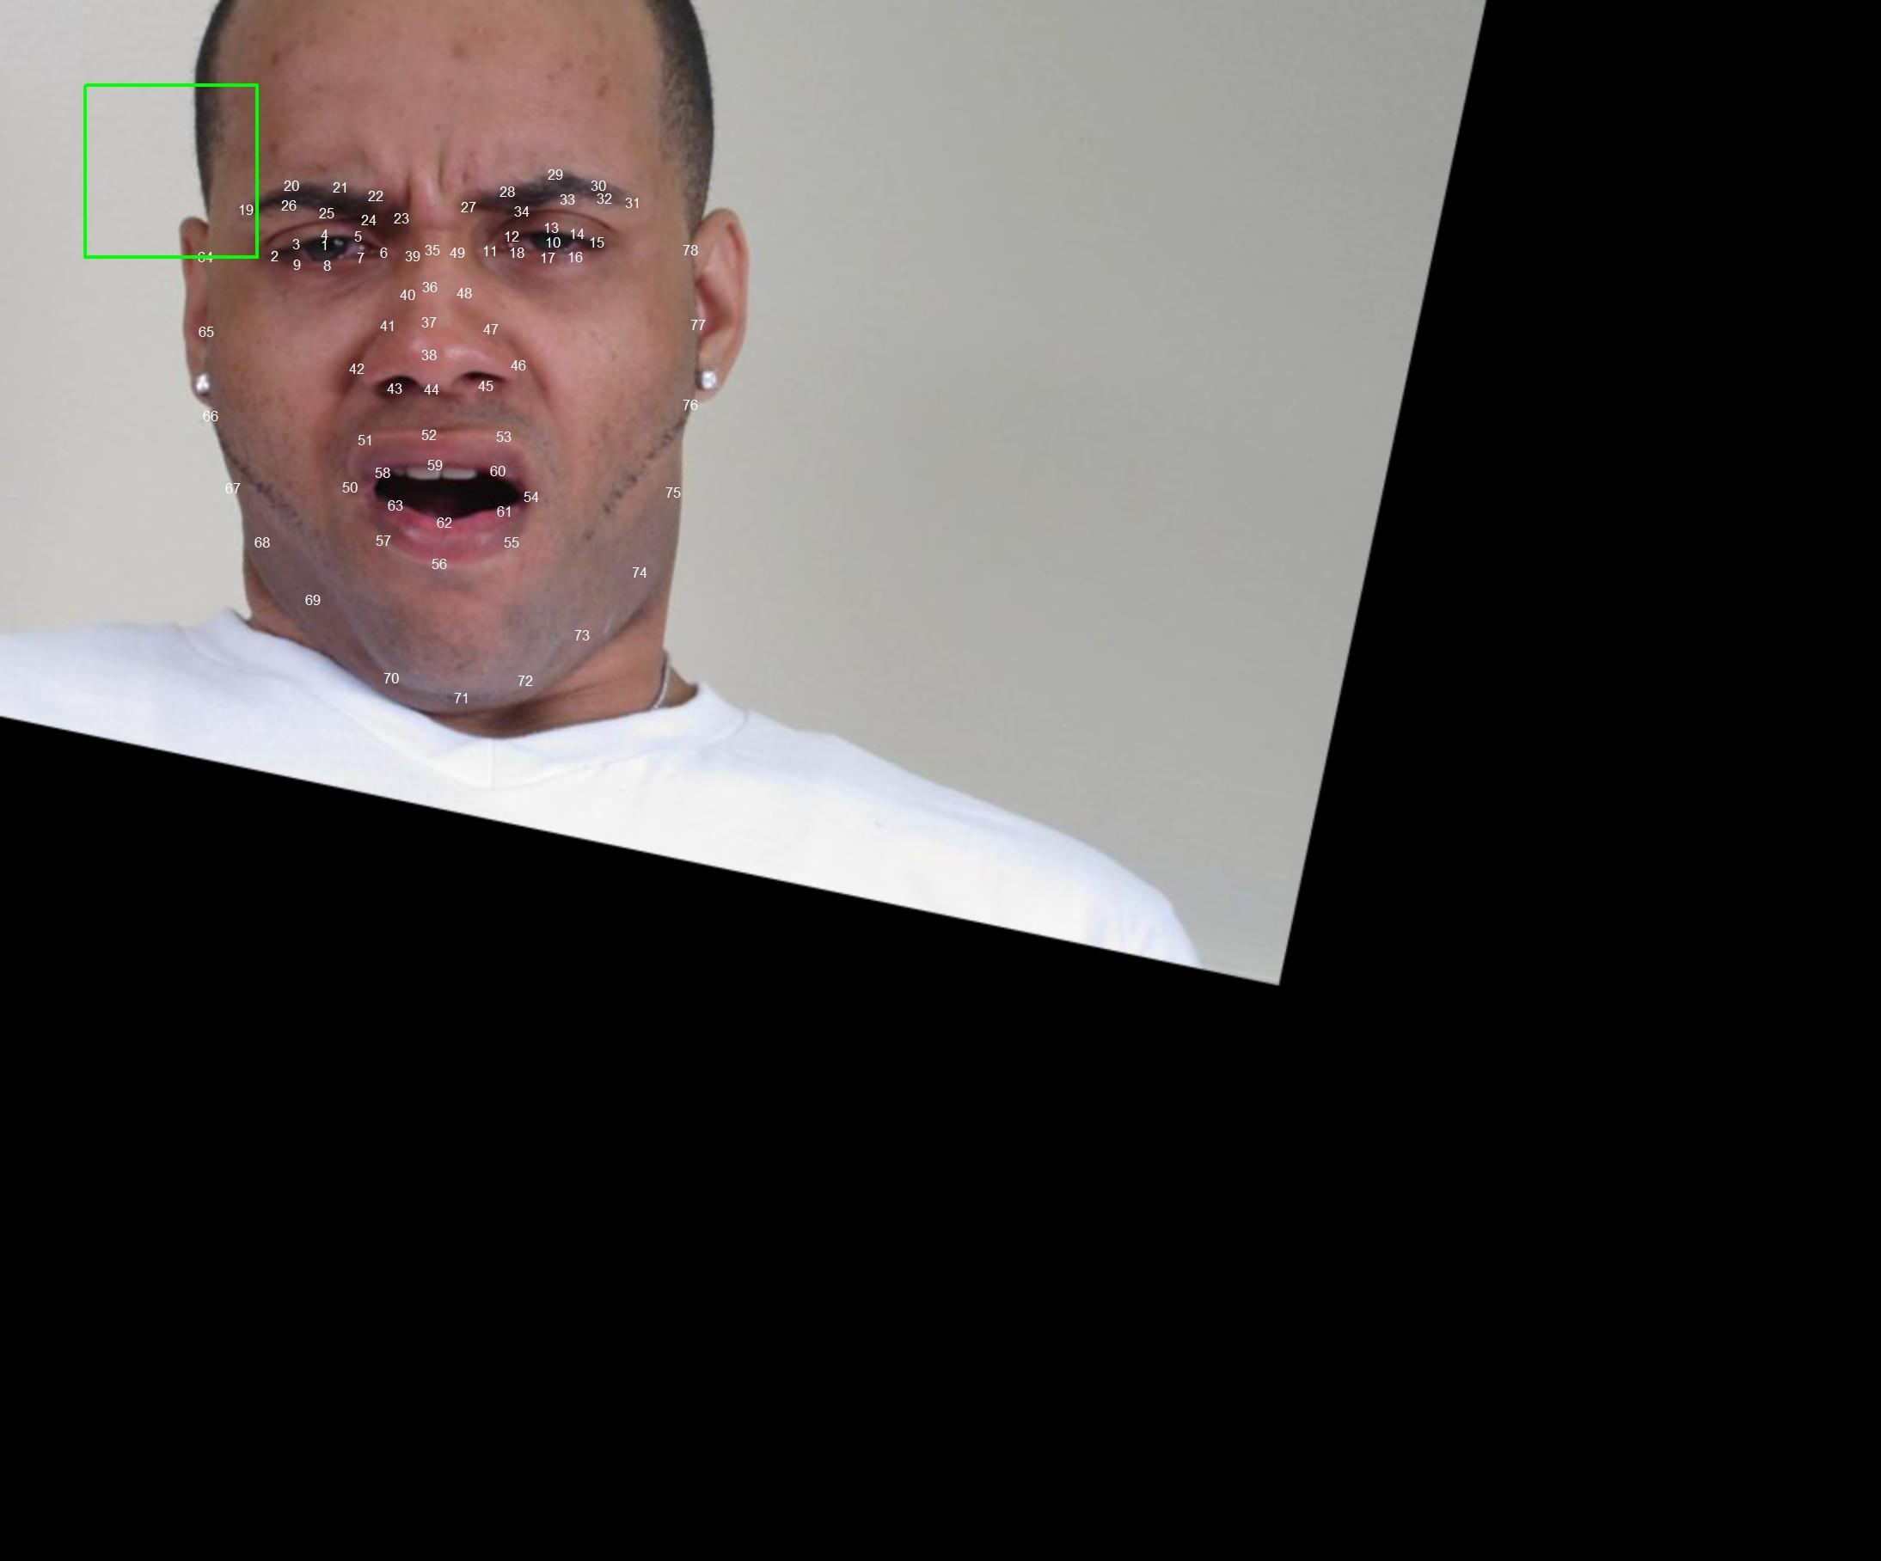
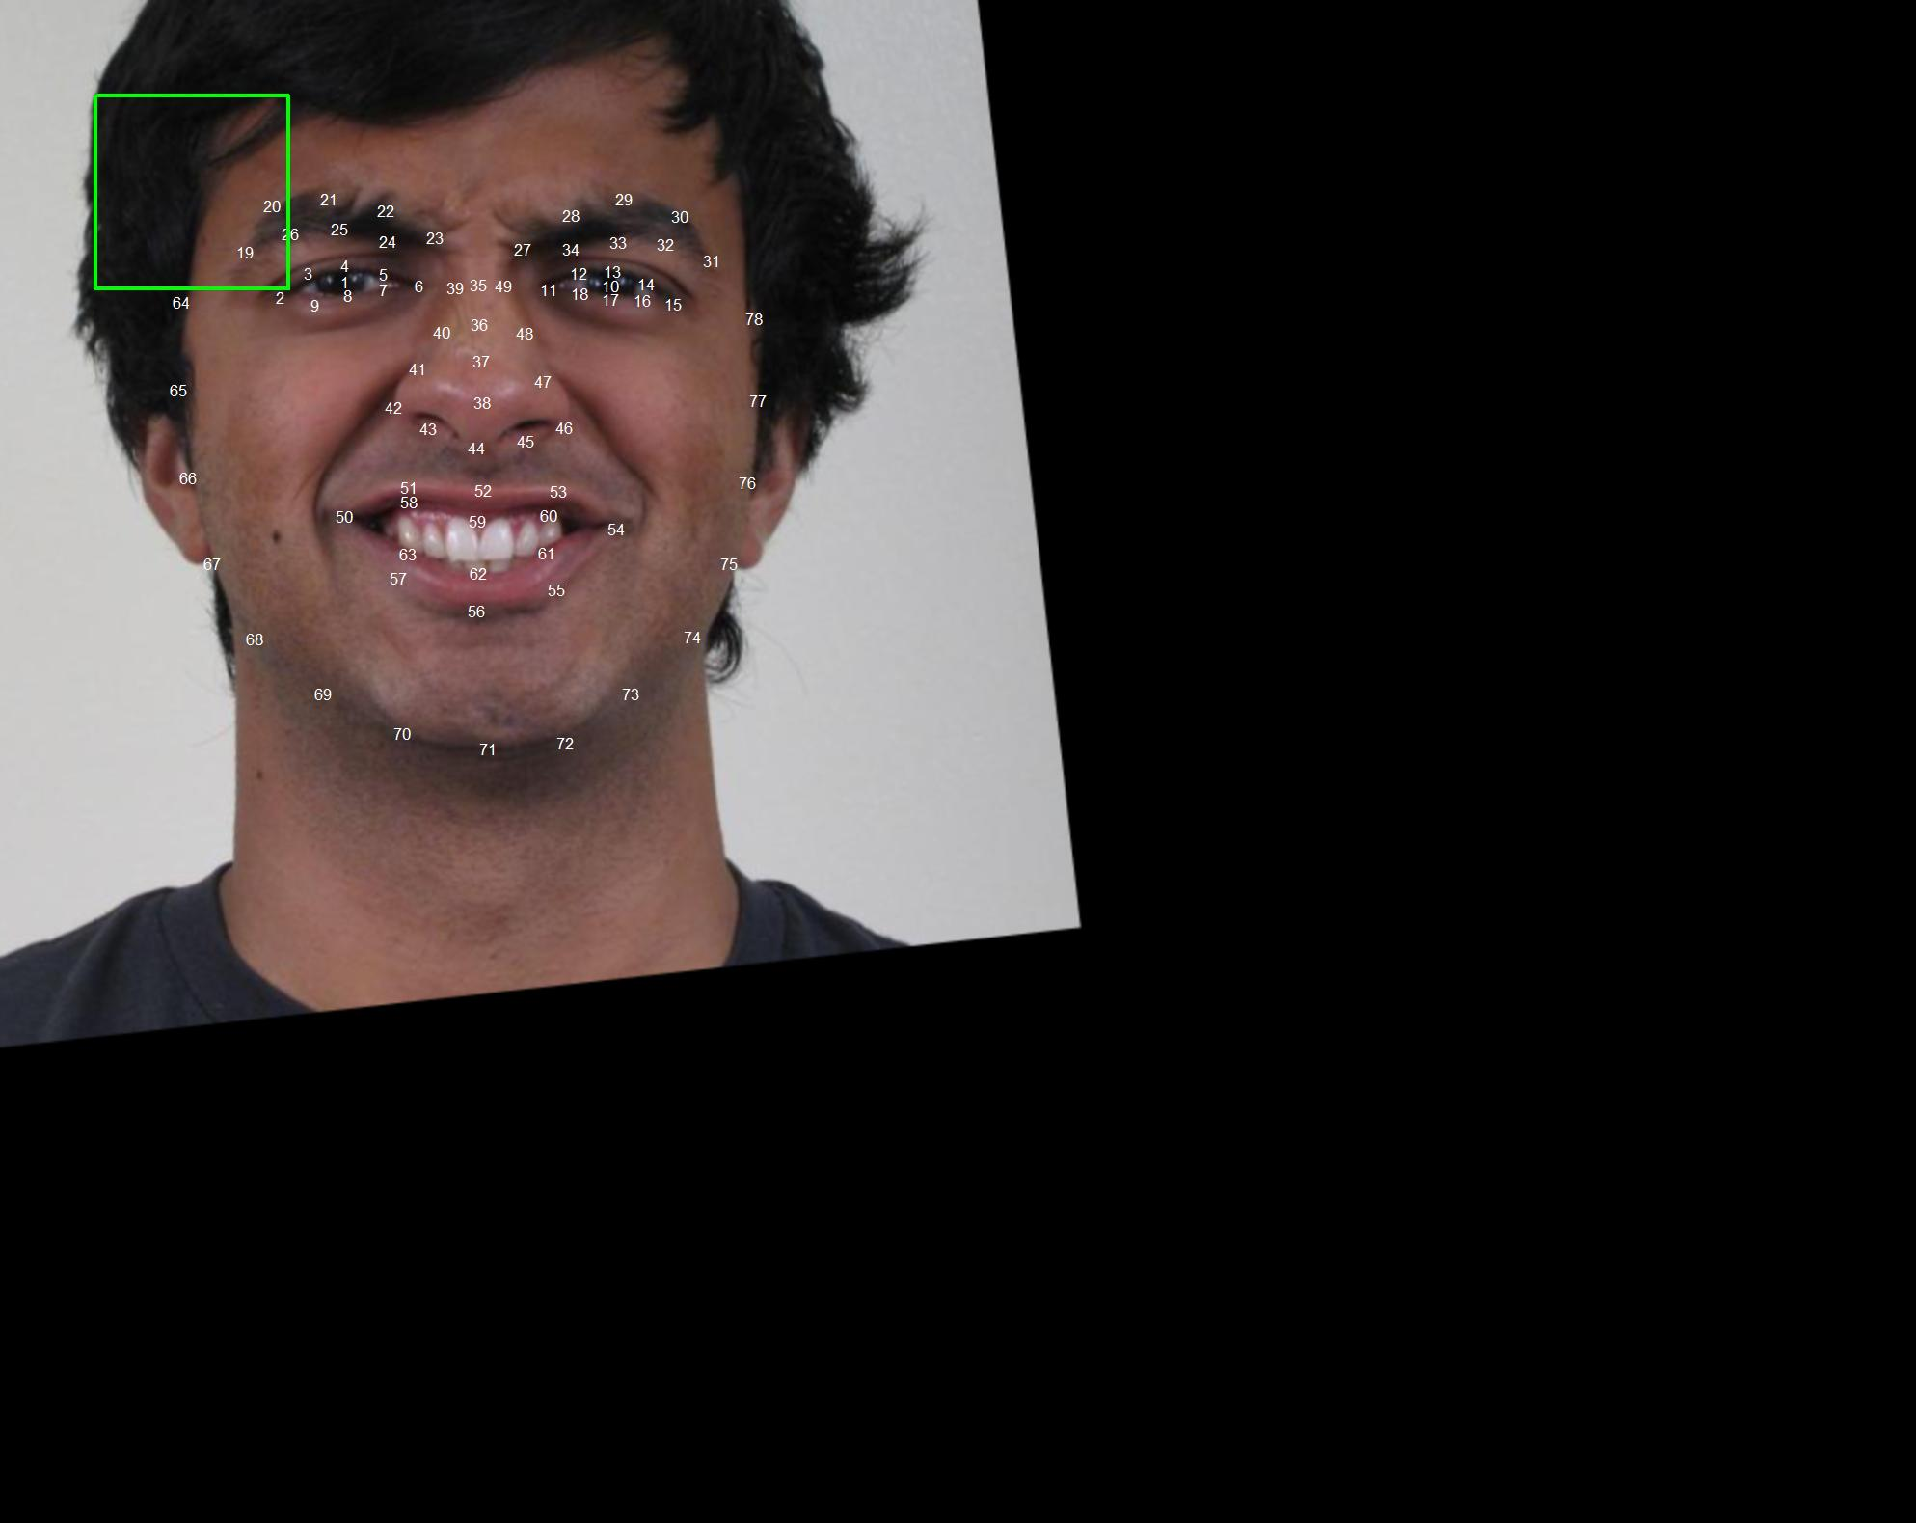
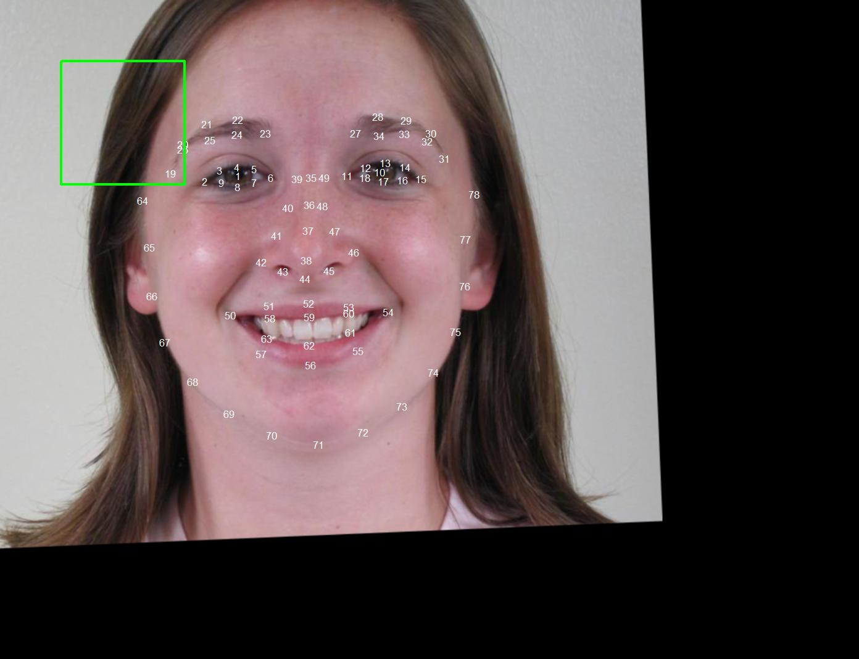
Data preprocessing - 5
Although the face area has become smaller visually, it contains more pixels.
Then we translate image’s number 37 point to the (500, 375). And put the other points to the appropriate position.
Image 2375
Image 0944
Image 0113
All good!
All good!
All good!

Slide 9
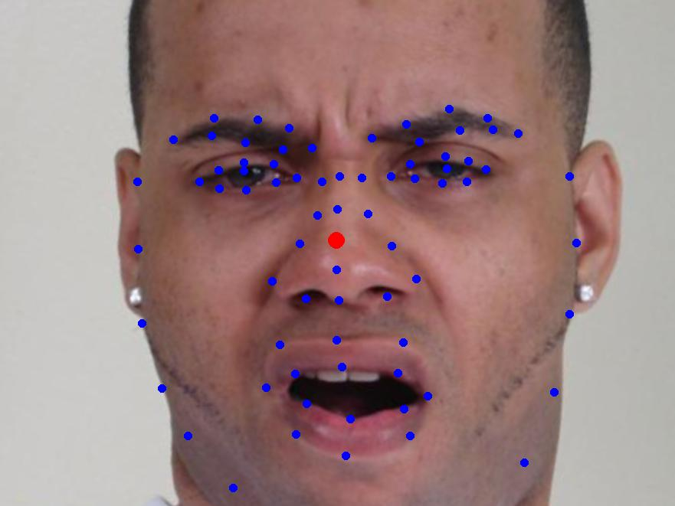
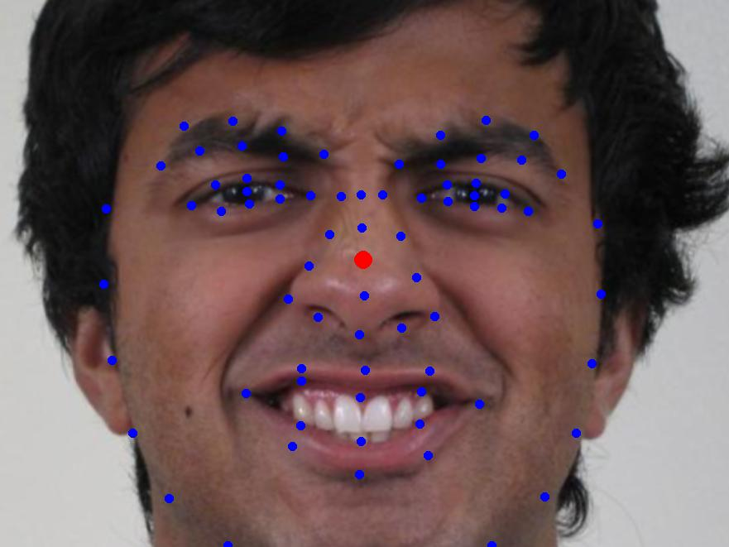
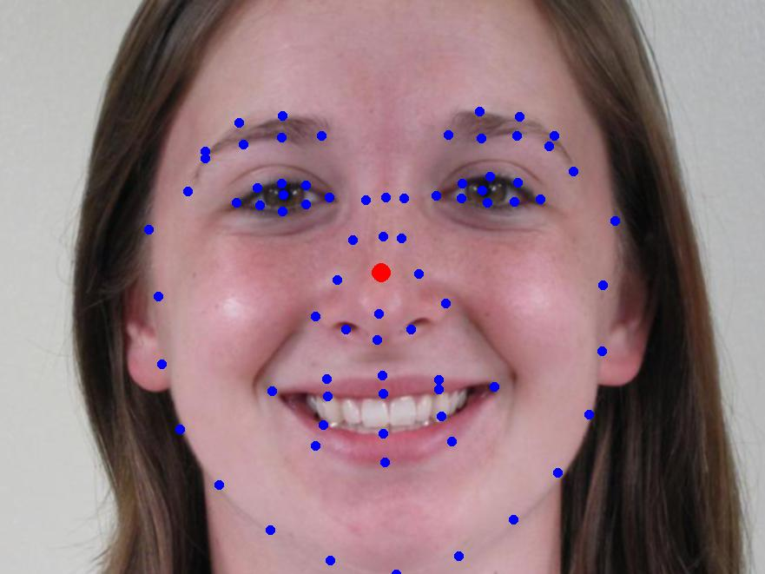
Data preprocessing - 6
Choose part of image to observe possible features.
The blue points is new feature points after rotation, zoom and translation.
The red points is the center (500,375)
Image 2375
Image 0944
Image 0113
Perfect!
Perfect!
Perfect!
What can we do base on these images?

Slide 10
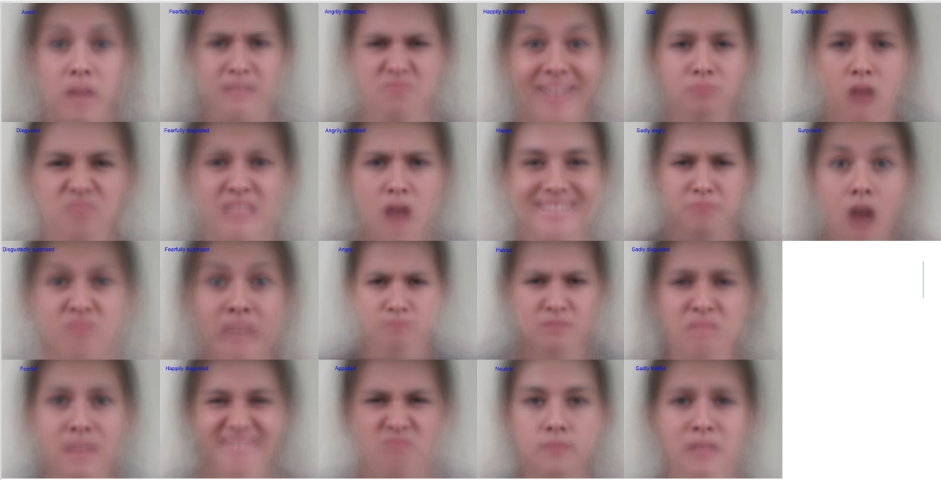
Data preprocessing - 7
HD images are saved in the ‘fig’ folder of our project.
It looks like there are more female images in our training set.
The average image of each emotion!

Slide 11
02
Feature extraction
Including points features and image features

Slide 12




Feature extraction
The color is green means we used this feature.
The color is grey means we didn’t choose it.
What kind of features can we use?
Point coordinates
Distance features
Since we have just finished the data preprocessing, the positions of all points should be standardized. Their coordinates are valid features. We have 78 feature points. Except for the center point with the same location, the feature dimension is 154.
In the baseline, 78 points pairwise distance are used, but we don't need so much. In fact, we can select some efficient distances to express nearly all the information. We extracted about 90 distance features.
1
2
3
4
Geometric features
Color features
In addition to distance, the slope between two points, the angle between three points, the area within the point set, and the regression coefficient of several points are all features that can summarize the expression. We took about 40 such features.
In addition to the features that can be obtained from 78 points, information can also be obtained from the image, such as forehead wrinkles and nasolabial folds. We use a proportion of pixels much darker than skin tones in an area to express these features. The dimension of these features is 10.

Slide 13
03
Classifier application
Including GBM, SVM and XGBoost.

Slide 14
Classifier application
When randomly selecting a 20% test set, we are not randomly selecting 20% images, but randomly selecting all images for 20% people.
Gradient Boosting Machine(GBM)
eXtreme Gradient Boosting(XGB)
Classifier parameters:
n.trees = 200,
bag.fraction = 0.8,
shrinkage = 0.1,
cv.folds = 3.
Features and dimension:
Baseline (distance), dim = 6006.
Improved (distance + geometric),
dim = 129.
Colored (distance + geometric +
color), dim = 139.
Classifier parameters:
eta = 0.05,
gamma = 0.1,
colsample_bytree = 0.6,
nrounds = 500,
Features and dimension:
Improved (distance + geometric),
dim = 129.
Colored (distance + geometric +
color), dim = 139.
45%
60%
55%
Support Vector Machine(SVM)
Classifier parameters:
kernel = 'poly’, degree = 1, gamma = 0.008
Features and dimension:
Improved (distance + geometric), dim = 129.
Colored (distance + geometric + color), dim = 139.
We extracted color features and
used the SVM classifier as our improved model.

Slide 15
04
Conclusion
Including accuracy analysis and time analysis

Slide 16
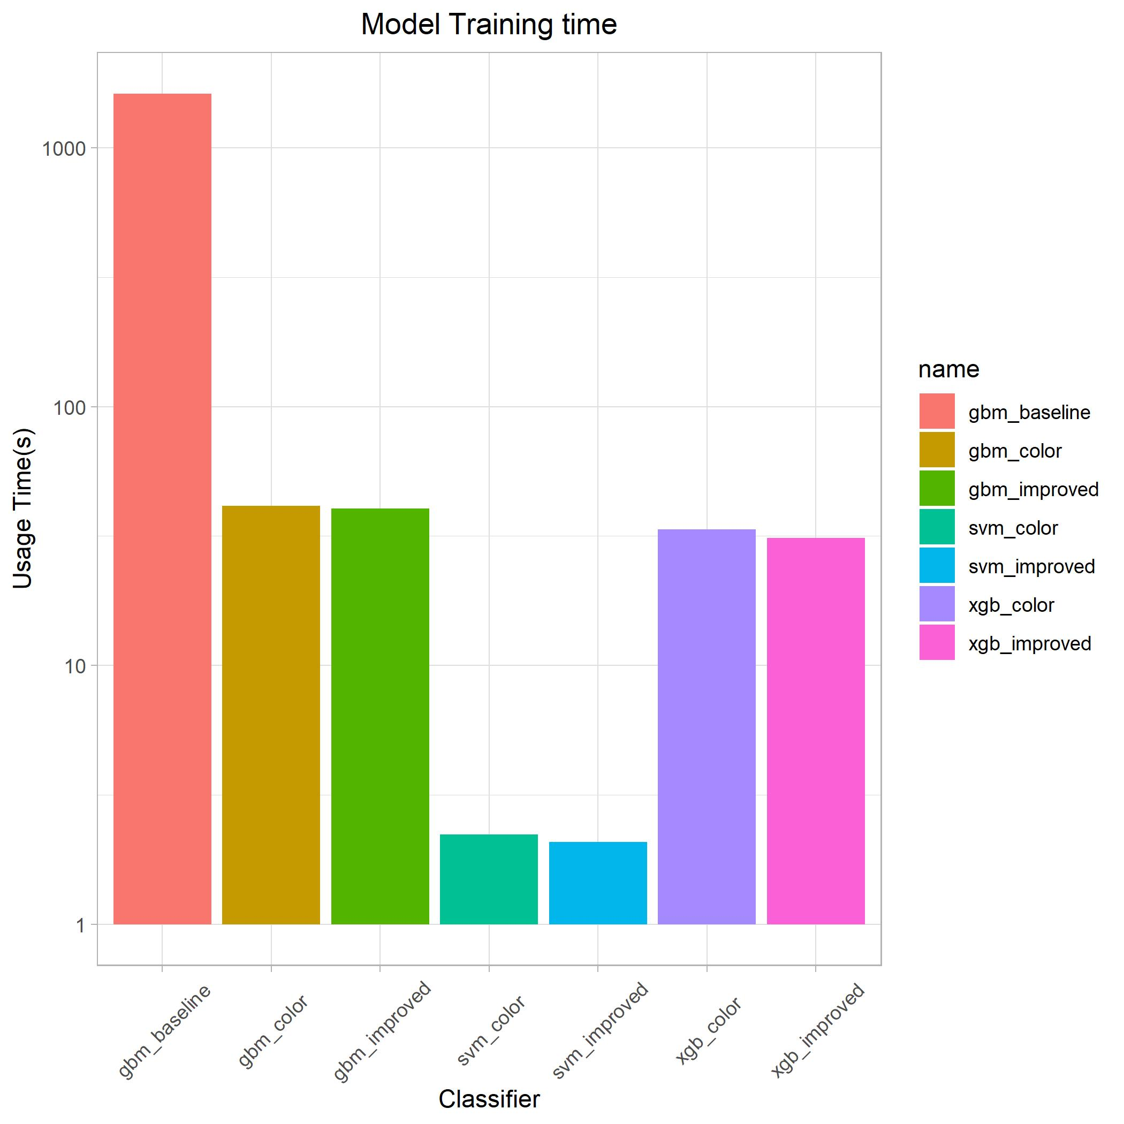
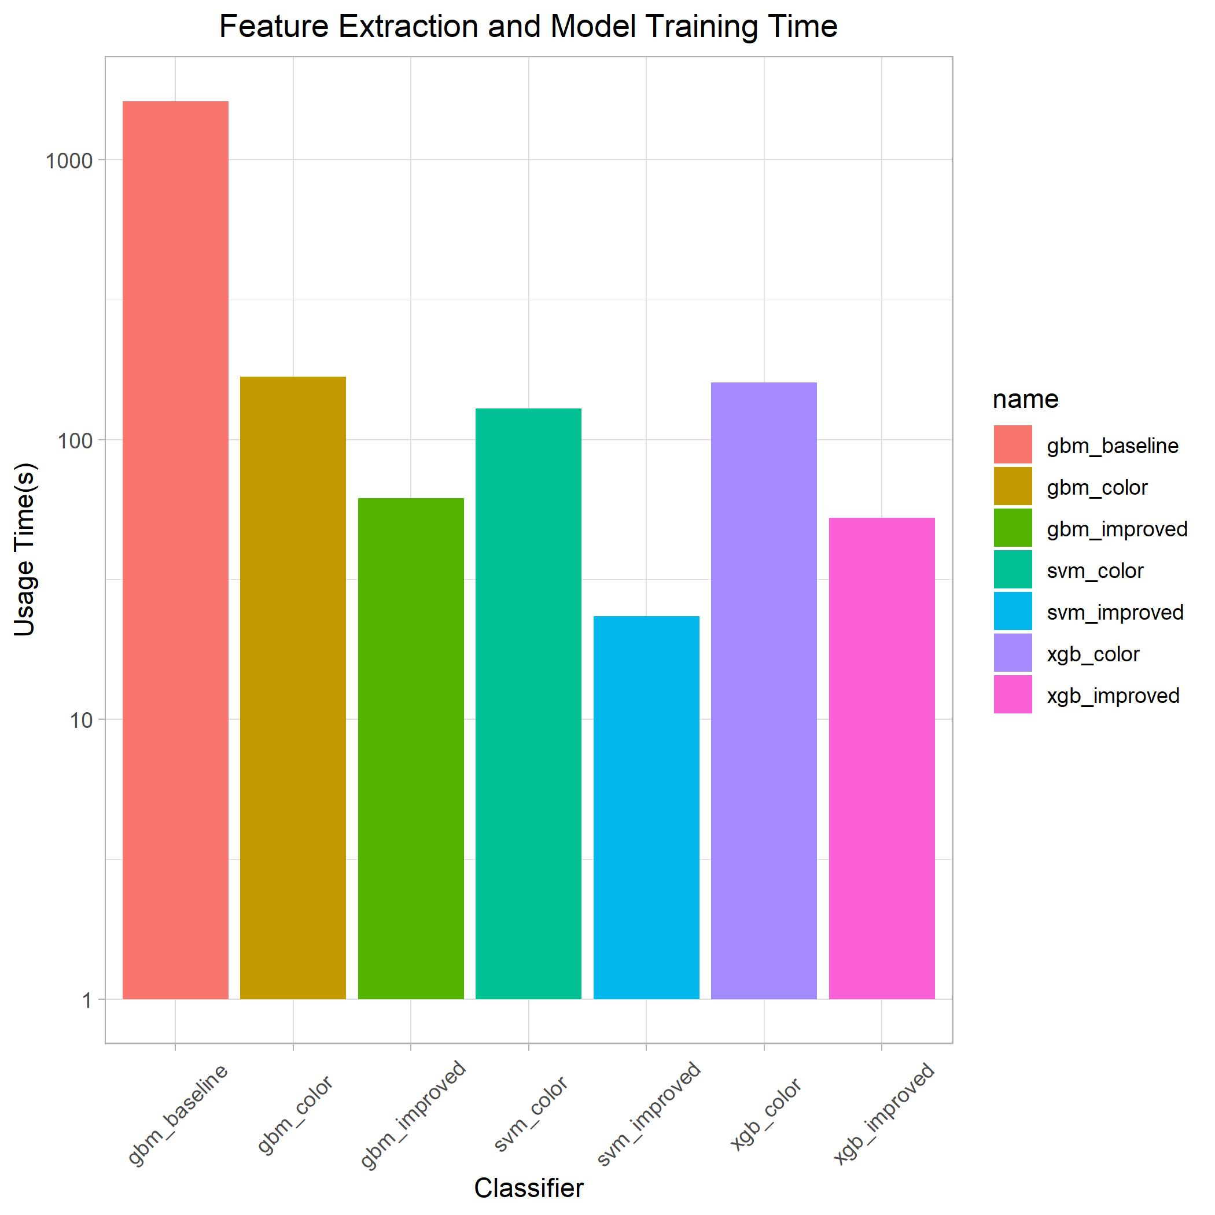
Conclusion - 1
Total training time =
Data preprocessing time + Feature extraction time + Model training time
Training time for different methods

Slide 17
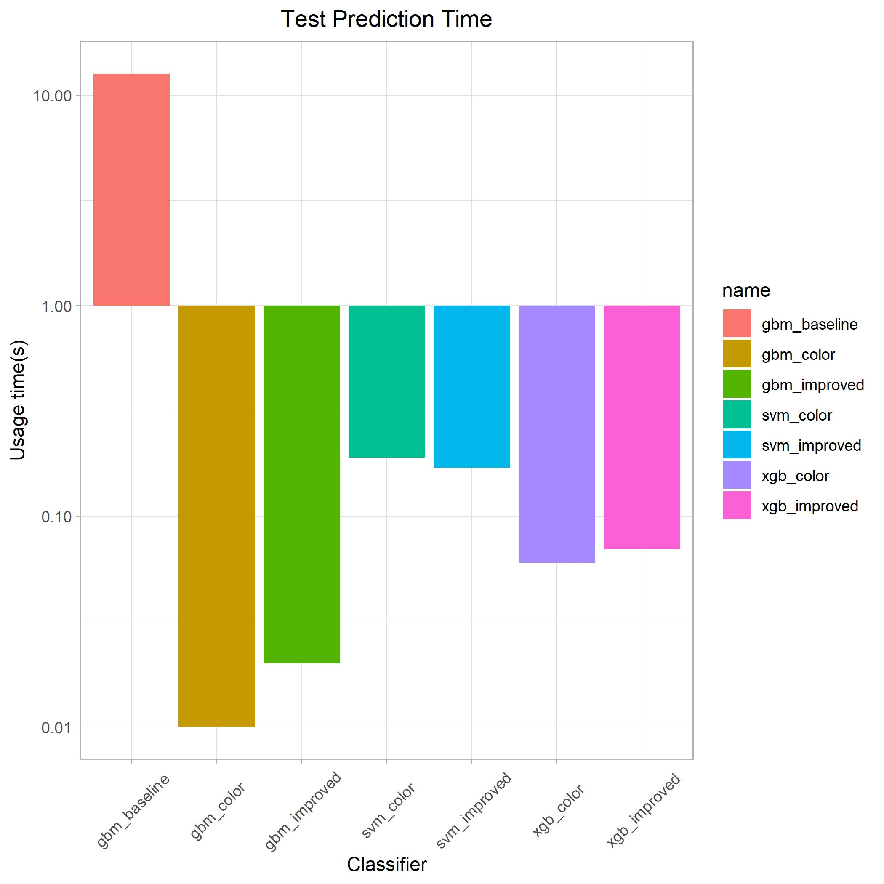
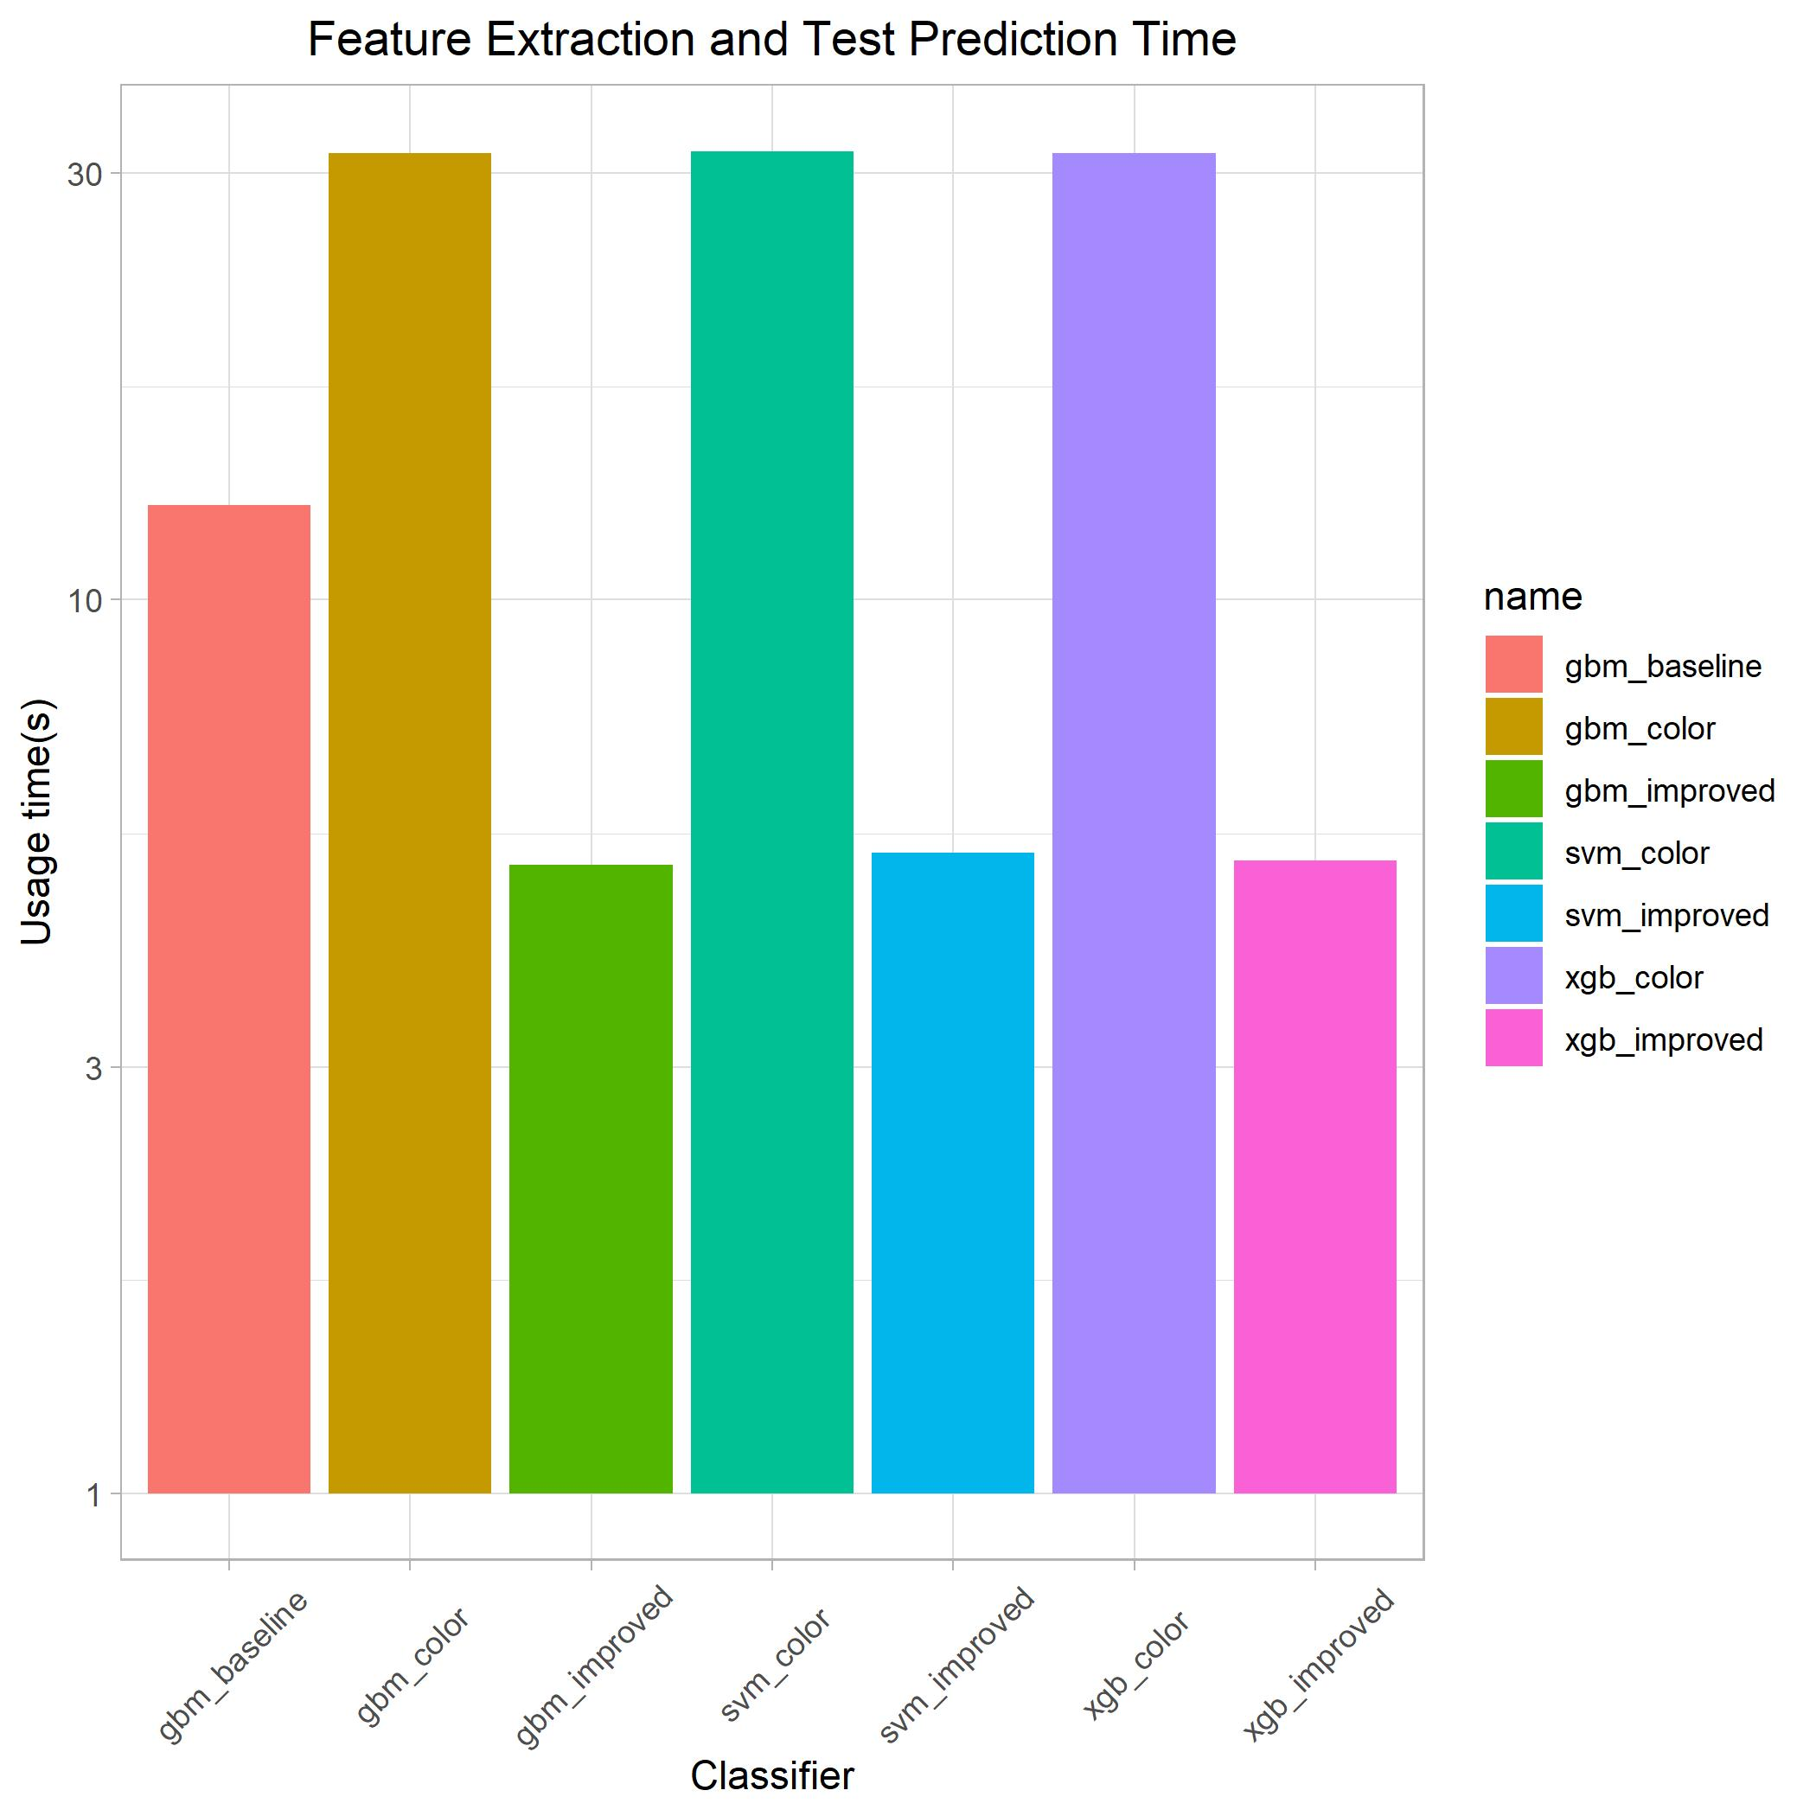
Conclusion - 2
Total test time =
Data preprocessing time + Feature extraction time + Test prediction time
Test time for different methods

Slide 18
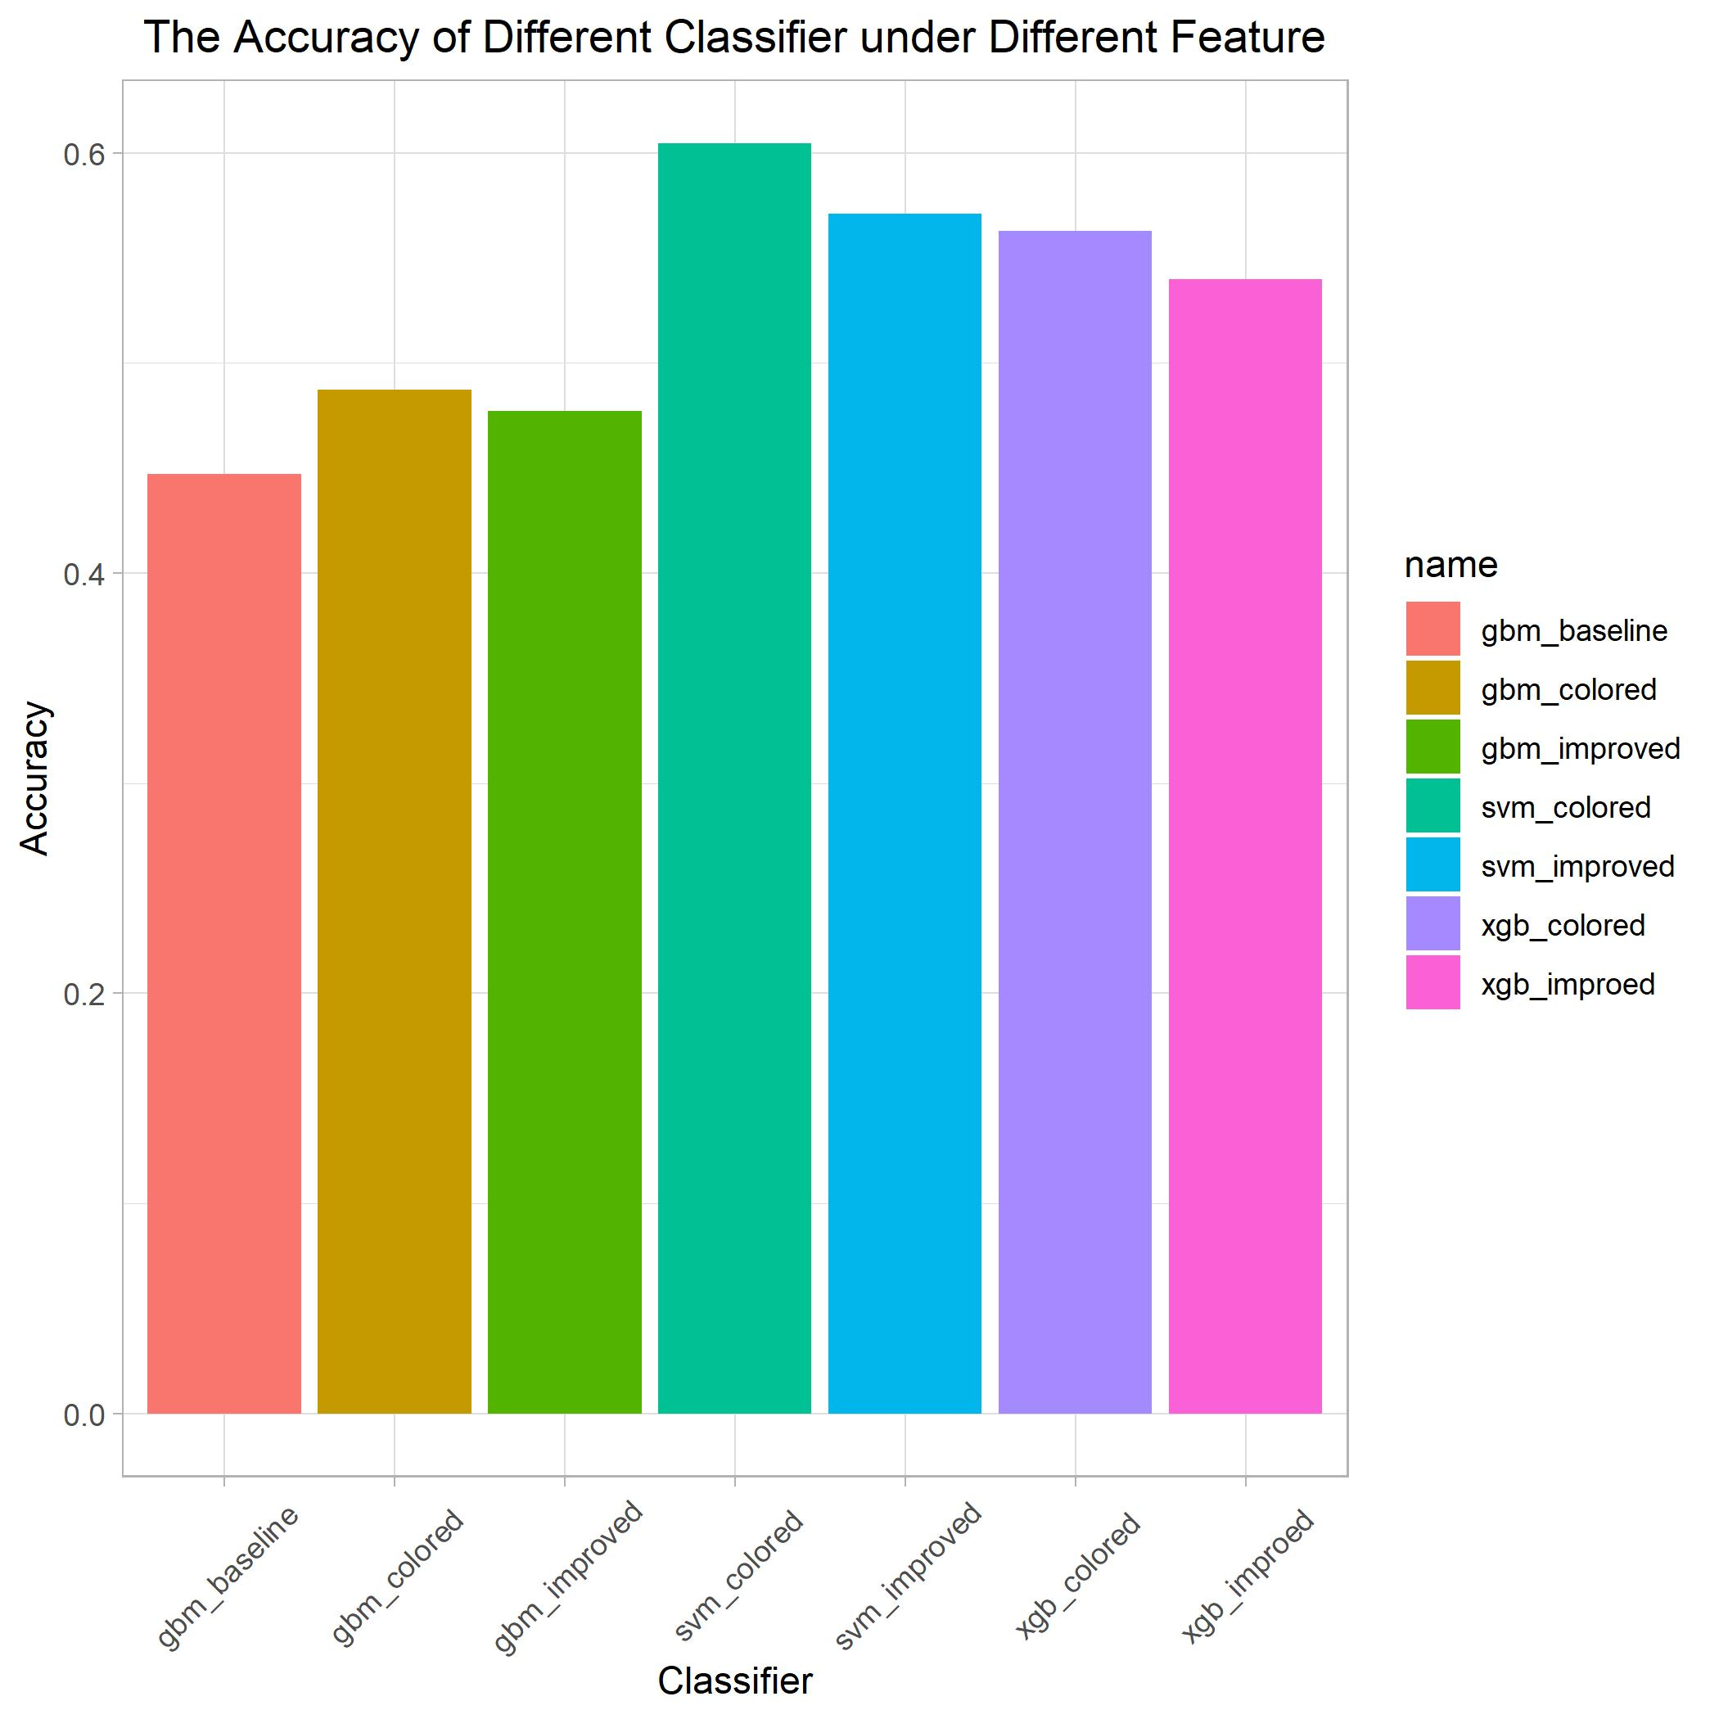
Conclusion - 3
60.46%
Prediction accuracy of different methods
If you re-plan the training and test data set each time, the resulting prediction accuracy will also be different.
Under same training and test data set, the training results of GBM and XGB are different each time. But results of SVM is always the same.

Slide 19
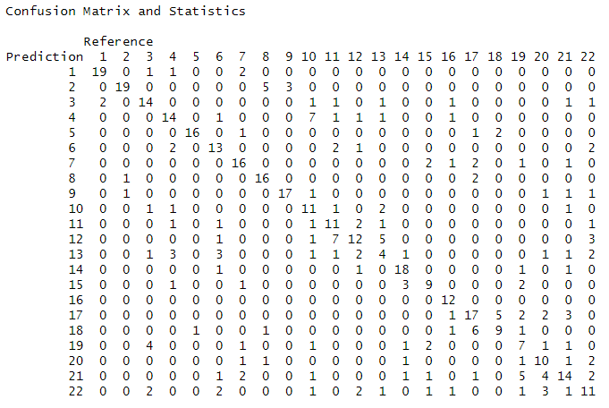
Conclusion - 4
This matrix is the result from the SVM classifier using color features.
Note that the number of test data for each facial expression is not equal.
Which classifications are most confusing?
As you can see from the confusion matrix on the left, the number 10 expression and the number 4 expression are highly confused. These two number indicate ‘Sadly angry’ and ‘Angry’. The confusing classifications are as follows：
‘Angry’ and ‘Sadly angry’;
‘Appalled‘ and ’Hatred’;
‘Awed’ and ‘Fearfully surprised’;
‘Happy’ and ‘Happily surprised’;
‘Sadly fearful’, ‘Fearfully disgusted’
and ‘Fearfully angry’ ;
………………

Slide 20
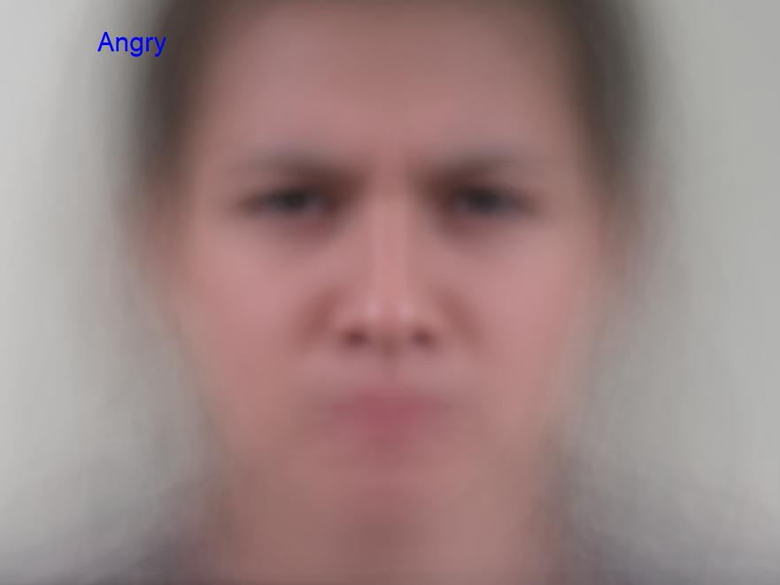
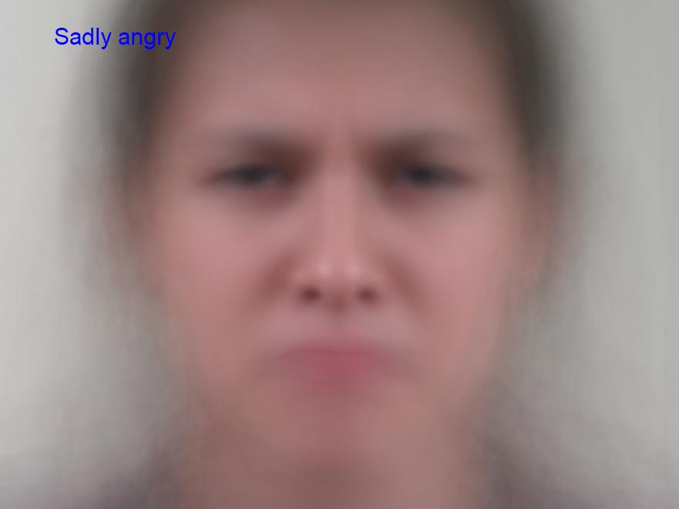
The two images are slightly different near the eyes, and the darkness of the nasolabial folds is different.
But I'm not sure if I can correctly classify by staring them.
Conclusion - 5
What do these confusing classifications look like?
‘Angry’ vs ‘Sadly angry’

Slide 21


Computer configuration:
System: Microsoft Windows 10 x64 | GPU: NVIDIA GeForce RTX 2070 SUPER (8192 MB)
CPU: Intel(R) Core(TM) i7-9700K CPU @ 3.60GHz(3600 MHz) | RAM: 16.00 GB (2400 MHz)
Conclusion - 6
Prediction of in-class test
We choose color features and SVM classifier to make predictions. The test time of about 500 test sets is 40s, so we predict that the test time of 2500 test sets is 200s. Under the same computer configuration as above, the calculation time is 200s. If you use a MacBook air, the time will be doubled to 400s.
Since the test accuracy is related to the selection of the training and test sets, it is difficult to make accurate prediction. After comprehensive consideration, we believe that the accuracy of the in-class test will be around 58%.

Slide 22
THANK YOU

